Slide 1
Navigating APIs with R: An Introductory Overview
Julia Gustavsen
Agroscope
Notes:
This talk will cover everything you've always wanted to know about APIs in R, but were afraid to ask, including some of the basics of what APIs are, how to interact with them using R, and their use in data science. Additionally, we'll draw from a range of examples, including projects from my previous roles, as well as ongoing projects at Agroscope.
So why? Something I’ve been working with and using for a while, but was always tocurious to know more about how APIs work. So I wanted to share a bit this with you and some of the ways I’ve been using APIs in R.

Slide 2
Plan for today
Overview of APIs
What are REST APIs
Use cases applicable to data science
How to use an API with R

Slide 3
A bit about me
👋, PhD microbial ecology
🍁
5 years industry experience in Switzerland– bioinformatics
2 years at Agroscope in IT department
Freetime: hiking, skiing, rOpenSci
Notes:
Quickly about me, I have a PhD in microbial ecology , I am Canadian, I moved to Switzerland in 2016 and worked as a bioinformatician at a private company focused on personalized medicine. And I’ve been at Agroscope for a bit over 2 years.

Slide 4

What is an API?
Application Programmatic Interface.
What does application programmatic interface mean?
Not intended to be directly used by a human, but by a program or software
API makes accessible (often “exposes”) certain parts (e.g. functionality, data, services, etc.) that can be used by others.
Idea is that you do not need to understand the internals to be able to use or extract info.

Slide 5
API history
APIs tightly associated with web development (REST)
First mentions (but not called APIs)
Developped to simplify interfaces
Microservices....
1940
1950
1960
1970
1980
1990
2000
2010
2020
Dissertation by Roy Fielding
Notes:
Origins in the 1940s: Believe it or not, the concept of APIs has been around for quite a while, even though it wasn't formally termed as such back then. In the 1940s, developers were already exploring ways to allow different programs to communicate. This laid the groundwork for what would eventually become known as APIs.
Liberating from Specifics: As technology advanced, developers faced the challenge of writing code that could work across different programs and devices. APIs emerged as a solution, liberating individuals from the intricacies of specific software or hardware. They provided a standardized way for different systems to interact.
Web APIs in the 2000s: The real explosion of APIs, especially in the public consciousness, happened in the 2000s with the rise of web APIs. These APIs made it possible for developers to access and use functionalities over the internet, leading to the creation of a myriad of web services we use today. It was introduced by Roy Fielding in his doctoral dissertation in 2000.
Interoperability without Exposing Inner Workings: One of the key roles of APIs has always been to provide interoperability. They allow systems to work together seamlessly without needing to understand each other's internal workings. This abstraction enables collaboration and integration on a broader scale.
Microservices Revolution: In recent years, the concept of microservices has further propelled the importance of APIs. Microservices architecture relies heavily on APIs for communication between small, independent services. This has led to more modular, scalable, and maintainable software systems.
Remember, this historical journey is a testament to the adaptability and importance of APIs in the ever-changing world of technology.

Slide 6




What can I use an API for?
Programmatically controllng software
Getting and sending data
Notes:
So there are many things that you can use an API for, but we will look at two main concepts today.
One way ot using APIs for getting and sending data. This is often in the context of web services, but could also be something more internal.
A second is a way to programmatically control software. This is a usage that is very usefl in automating tasks and analysess.
So far we have been talking about APIs in general, but we can be a bit more specific and talk about REST APIs

Slide 7

What is a REST API?
Representational State Transfer Application Programmatic Interface
This is generally the common meaning of API nowadays
Adhere to a structured set of principles
Photo by Sven Mieke on Unsplash
Notes:
Means that a server will respond with a representation of a resource....
When you make a request to a REST API endpoint, you are essentially asking the server for information about a particular resource (e.g., a user, a piece of data, an image).
How does this compare to a non-REST API: Communication protocol is http methods, commonly use JSON and XML,
Other types of APIs exist with different architechtures, communication protocols and standards.
Follow a structured set of principles, we will see what these are a bit later.

Slide 8

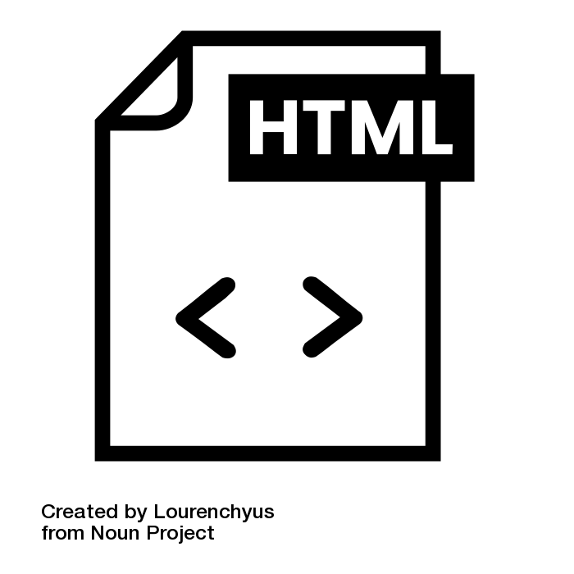
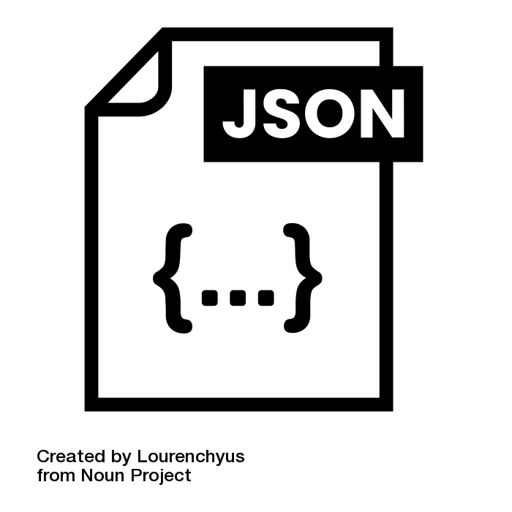
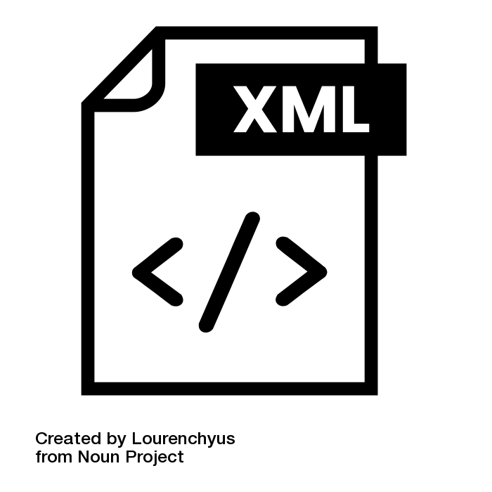
Representational State transfer? Concept
“Client”
Request
Response
Resource
Representation
Notes:
Imagine an image that you are interested in working with....
In the context of REST APIs, the term "representation" refers to the data or information about a resource that the server sends back to the client in response to a request. When you make a request to a REST API endpoint, you are essentially asking the server for information about a particular resource (e.g., a user, a piece of data, an image).
In REST, the concept of "state" emphasizes that each resource is self-contained and carries its complete information. The state of a resource is represented and exchanged between the client and server during interactions, allowing the client to understand and manipulate the resource's data without needing to be aware of its internal workings
Here's a breakdown of the concept:
Client
Request
Resource:
A resource is an entity or concept in your application that can be identified and manipulated. It could be anything from a user profile to a data record, an image, or a document.
Representation:
The representation is how the server presents the information about the resource. It could be in various formats such as JSON, XML, HTML, or others, depending on the API and the client's request headers.
Response:
When you make a request to a REST API, the server responds with a representation of the requested resource. This representation typically contains the data associated with the resource and may also include metadata or additional information.
So what bout
Statelessness – 1st time is the same as the 100th time.... No information
Is saved about your requests, nor about what you have already requested
Independent and self-contained....
Stateful and statelessness...

Slide 9

REST principles
Hi! My name is...
Interface A
=
Interface B
Client
Server
Client-Server Architechture
Uniform interfaces
Statelessness
application
data
Resource
Server
client
Resource-based
Representations
Cachebility
Layered system
Notes:
Don’t necessarily need to understand (or care about) these principles right now, but can help you understand the usage of APIs. Would be essential for developing an API.
REST principles are intended to create scalable, maintainable, and loosely coupled systems. Here are the key principles of REST:
1. Statelessness:
- Each request from a client to a server must contain all the information needed to understand and process the request. The server should not store any information about the client's state between requests. This makes the system more scalable and easier to manage. Imagine a conversation between two people. In a stateful conversation, they remember the context of the previous statements. In a stateless conversation, each statement is independent, and there is no memory of what was said before. In REST, the communication between the client and server is more like a series of stateless conversations.
The statelessness principle in REST means that each request from a client to a server contains all the information needed to understand and process the request. The server does not store any information about the client's state between requests.
2. Client-Server Architecture:
- The system is divided into client and server components, each with distinct roles and responsibilities. The client is responsible for the user interface and user experience, while the server is responsible for processing requests, managing resources, and handling business logic.
3. Uniform Interface:
- The uniform interface is a set of constraints that simplifies and decouples the architecture. It includes:
- Resource Identification: Resources are identified by URIs (Uniform Resource Identifiers).
- Resource Manipulation through Representations: Clients interact with resources through representations, such as JSON or XML. The server sends representations to the client, and the client sends representations to the server to perform operations on resources.
- Stateless Communication: Each request from a client to a server must contain all the information needed to understand and process the request.
4. Resource-Based:
- Resources, which can be any information or service, are identified by Uniform Resource Identifiers( URIs). Resources are manipulated using standard HTTP methods (GET, POST, PUT, DELETE) to perform operations like retrieval, creation, modification, and deletion. URIs are how images or other kinds of binary (non-text) data can be represented....kind of like a path.
5. Representation:
- Resources can have multiple representations, such as JSON, XML, or HTML. Clients interact with these representations rather than directly with the resources. The server sends representations to the client, and the client sends representations to the server.
6. Cacheability:
- Responses from the server can be explicitly marked as cacheable or non-cacheable. Caching improves performance and reduces the load on servers by allowing clients to reuse previously retrieved representations. Cacheability is about allowing clients to cache server responses to reduce the need for repeated requests, improving performance.
7. Layered System:
- The architecture can be composed of multiple layers, where each layer has a specific responsibility. Layers can be added or modified without affecting other layers, promoting scalability and flexibility. Layered System is about organizing the architecture into distinct layers, each with a specific role. This enhances scalability, flexibility, and the ability to modify or extend parts of the system without affecting others.
By adhering to these principles, RESTful systems can achieve desirable properties such as scalability, simplicity, and a uniform interface, making them well-suited for distributed systems and the web.

Slide 10
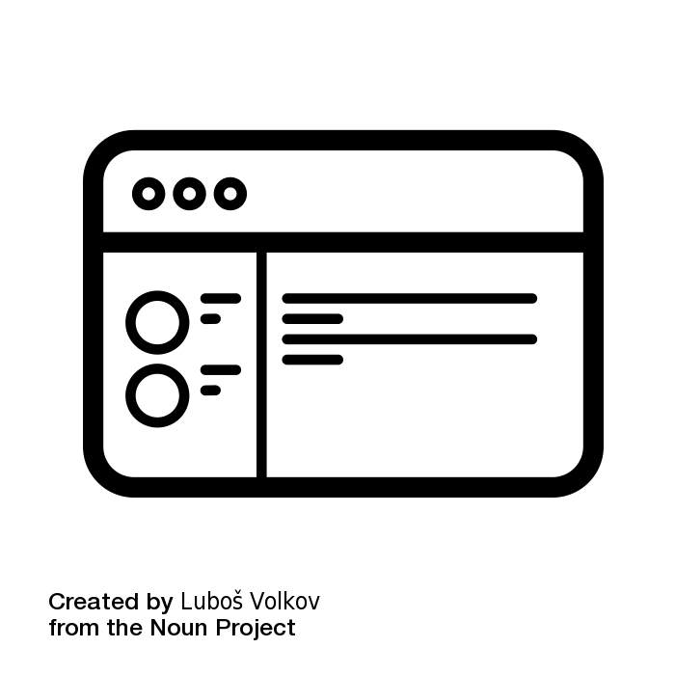
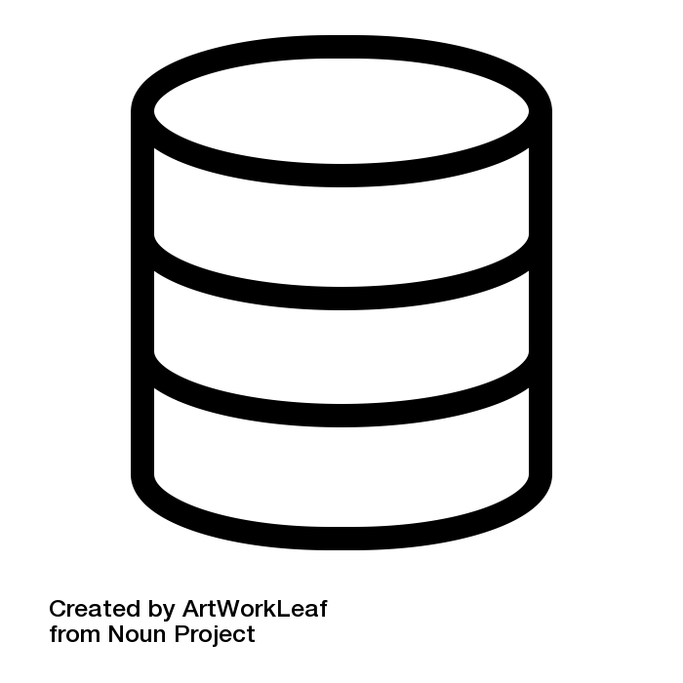

REST API
Web scraping
html
Structured request
Structure response
Structured data exchange
Direct extraction
Html parsing
Notes:
Is using a REST API like web scraping? In a word. No.
REST API:
Show the client sending an HTTP request with a specific endpoint (e.g., "/users") to the server. The server responds with a representation of the requested resource, such as JSON data.
Emphasize the structured nature of the interaction, the use of standard HTTP methods, and the clarity of data exchange.
Web Scraping:
Show the client extracting data directly from the HTML structure of a website using the web scraping tool.
Highlight the lack of a formal API and the more intricate process of parsing and extracting data from the HTML structure.
What about the use of https://github.com/dmi3kno/polite? GIve examples of use cases. -- this is only about webscraping

Slide 11
What is a request / response?
Request
Web browser
R
GET
/api/data
[Authorization, Content-Type]
{ "key": "value" }
HTTP
Method
Endpoint/URI
Headers
Body
Client
Response
API Server
200 OK
[Content-Type, Cache-Control]
{ "result": "success", "data": [...] }
Server
Status code
Headers
Body
Notes:
Request:
Structure: The API request is like a letter to the server, containing specific instructions.
Components:
Endpoint: The destination address or URL where the request is sent.
HTTP Verb: Specifies the action to be performed (GET, POST, etc.).
Headers: Additional information or metadata about the request.
Body: Data or parameters sent with the request, especially for POST and PUT requests.
Response:
Structure: The API response is like a reply to the letter, providing the requested information or confirming an action.
Components:
Status Code: A three-digit code indicating the outcome of the request (e.g., 200 for success, 404 for not found).
Headers: Metadata about the response, such as content type or server information.
Body: The actual data or information requested by the client, formatted based on the agreed-upon representation (JSON, XML, etc.).
Flow:
Initiation: The client initiates the process by sending a request to the server.
Processing: The server processes the request, performs the necessary actions, and generates a response.
Transmission: The server sends the response back to the client, typically over HTTP or HTTPS.
Interpretation: The client interprets the response, checks the status code, and extracts the relevant data from the response body.

Slide 12
HTTP verbs used in APIs
*NEW
My awesome file
Your awesome file
POST
GET
Resource
A different awesome file
PUT
X
DELETE
Your
PATCH
Notes:
In our requests we are using a specific vocabulary
POST:
Purpose: Used to submit data to be processed to a specified resource.
Action Analogy: Imagine filling out a form on a website. When you submit the form, you're making a POST request, sending data to the server for processing.
PUT:
Purpose: Used to update a current resource or create a new resource if it does not exist.
Action Analogy: It's like editing a document. You're specifying the changes you want to make, and the server updates the resource accordingly.
PATCH:
Purpose: Similar to PUT but typically used for partial updates to a resource.
Action Analogy: Think of it as making edits to specific sections of a document rather than replacing the entire document.
GET:
Purpose: Used to retrieve data from a specified resource.
Action Analogy: Think of it like asking for information. When you enter a URL in your browser, you're making a GET request to the server to fetch a web page.
DELETE:
Purpose: Used to request the removal of a resource.
Action Analogy: Deleting a file on your computer. You're telling the server, "I want this resource gone."
There are other HTTP verbs that we will not mention, these cover the main uses that we are interested in.

Slide 13
Why JSON?
{ "key": "value" }
{ "result": "success", "data": [...] }
{
"name": "Daniel Müller”,
"age": 30,
"email": ”daniel.mueller@example.com",
"address": {
"street": "123 Dorfstrasse",
"city": ”Oberhof",
"zip": ”5062”
},
"skills": [”R", "Python", "RESTful APIs"],
"isStudent": false,
"grades": null
}
Human readable and Lightweight
Language Agnostic and Interoperable
Native support in Javascipt and Web Development
Notes:
Human-Readable and Lightweight:
JSON's syntax is human-readable and straightforward, making it easy for developers to understand and work with. The lightweight nature of JSON is crucial for efficient data interchange, especially in the context of web-based applications and RESTful APIs.
Language Agnostic and Interoperable:
JSON is language-agnostic, meaning it can be parsed and generated by a wide range of programming languages. This feature promotes interoperability, allowing systems built using different technologies to communicate seamlessly. JSON's versatility contributes to its adoption in diverse development environments.
Native Support in JavaScript and Web Development:
JSON is a native data format in JavaScript, which is a fundamental language for web development. Since many REST APIs are designed to serve web applications, the natural compatibility of JSON with JavaScript simplifies data manipulation, consumption, and integration within web-based projects. The prevalence of JSON in web development has contributed significantly to its widespread adoption in RESTful APIs.
Data Structure Representation:
JSON supports key-value pairs and nested structures, making it an effective way to represent complex data structures. This is especially useful when dealing with hierarchical data, such as nested objects and arrays.
Language Agnostic:
JSON is language-agnostic, meaning it can be easily parsed and generated by a wide range of programming languages. This flexibility allows interoperability between different systems, as JSON is supported in most modern programming languages.
Browser and JavaScript Compatibility:
JSON is a native data format in JavaScript, which is widely used for web development. This native compatibility simplifies data manipulation and consumption in web applications, making it a natural choice for APIs serving web-based content.
Widespread Adoption:
Due to its simplicity and versatility, JSON has gained widespread adoption across various industries and domains. Many programming languages provide built-in support for JSON parsing and serialization.
While JSON is prevalent, it's essential to note that other data formats, such as XML, may still be used in certain contexts. The choice of data format often depends on the specific requirements of the application and the preferences of the development team.

Slide 14

So......using APIs in R
What are the options for manipulating APIs in R?
(non exhaustive list) many different options, curl, crul, httr, httr2, Rcurl, using system calls from R, etc..
Today we will mostly use httr2 in our demos.
Photo by CHUTTERSNAP on Unsplash
Notes:
From http testing: When writing a package interacting with web resources, you will probably use httr2, httr or crul.
Many great options...
Lots of flexibility

Slide 15
What about security for users while using APIs?
How to manage secrets – do not store passwords or tokens in scripts/packages.
Lots of good advice by Hadley Wickam in a httr vignette entitled Managing secrets , starts with storing in .Renviron file
also {secret}, {getPass}, {keyring}, {cyphr}
Sensitive data – use only HTTPS
Data privacy, understand where your data are headed....
Notes:
https://cran.r-project.org/web/packages/httr/vignettes/secrets.html

Slide 16
R Demos
Use cases for APIs that I am familiar with:
Traditional web APIs: examples: Github, DeepL
Software with GUI that could be automated: {RCy3} for Cytoscape
Notes:
Rsnps
Softare, other examples – Spotify, Unity

Slide 17

Cytoscape
Open source Software that is used for visualizing networks
Can use desktop software with graphical user interface
Also REST API available and Python and R packages that wrap the REST API
In R this is {RCy3}
A large amount of development has gone into providing automation possibilities in Cytoscape
Notes:
Using httr
Installation not workng
```{r}
if (!require("BiocManager", quietly = TRUE))
install.packages("BiocManager")
BiocManager::install("RCy3")
```

Slide 18


Agroscope use cases
Deepl
Note: this is outside of the Confederation’s DeepL pro account (which makes sure that the texts translated are not saved).
Use case: IT ticketing system, preparation for input into NLP
Firecrest
API for the Swiss National Supercomputer Center
Allows us to transfer data from our research network
There is a recommended tool, Globus, but it does not work with the proxy, so this is a great alternative for us.
Allows us to launch jobs

Slide 20
Conclusion
🚀 First steps: Today’s talk and demos were a basic introduction to APIs and interacting with APIs using R.
🌐 Endless possibilities: APIs are the gateway to a vast world of data and services on the web. Many creative possibilities exist....
⚙️ Streamlined workflows: If you've faced limitations workflows , consider APIs as a powerful solution. R provides not only convenient wrappers for APIs but also the flexibility to communicate directly with them.

Slide 21
Questions?

Slide 23
APIs is R
There are several R packages that have been widely used for dealing with REST APIs. These packages facilitate making HTTP requests, handling responses, and parsing data in R. Here are some popular ones:
1. **httr:**
- **Description:** A versatile package that provides functions for working with URLs, HTTP methods, headers, and other aspects of HTTP.
- **Example:**
```R
library(httr)
response <- GET("https://api.example.com/data")
content(response)
```
2. **curl:**
- **Description:** Offers a modern and flexible R interface to libcurl, a widely used library for handling HTTP requests.
- **Example:**
```R
library(curl)
handle <- new_handle()
response <- curl_fetch_memory("https://api.example.com/data", handle = handle)
```
3. **jsonlite:**
- **Description:** A lightweight package for JSON parsing and generation. Useful for handling JSON data often returned by REST APIs.
- **Example:**
```R
library(jsonlite)
data <- fromJSON('{"name": "John", "age": 30}')
```
4. **httr:**
- **Description:** A package for working with web APIs, making it easier to authenticate and access various web services.
- **Example:**
```R
library(httr)
token <- oauth2.0_token(
endpoint = oauth_endpoint(authorize = NULL, access = "https://api.example.com/token"),
app = oauth_app("client_id", "client_secret")
)
```
5. **plumber:**
- **Description:** While primarily known for creating web APIs in R, Plumber can also be used to consume REST APIs. It provides a flexible framework for API development and consumption.
- **Example:**
```R
library(plumber)
# Define an API endpoint
# ...
# Make a request to the API
response <- httr::GET("http://localhost:8000/your/endpoint")
```
These packages, among others, empower R users to easily interact with REST APIs, send HTTP requests, handle responses, and manipulate data, facilitating seamless integration of R with various web services.

Slide 24
REST vs non-REST API
 | REST API | non-REST API
Architectural style | Adheres to principles of REST Stateless communication primordial | Can follow other architechtural designs such as SOAP, GraphQL or others.
Communication protocol | Generally HTTP mehtods Standard HTTP status codes | can use other protocols
Data format | often use JSON or XML for representation Resrouces identified by URIs(uniform resrouce identifiers) | can use XML or JSON or other formats
Documentation standards | Standardized conventions available and tools like Swagger or OpenAPI available | Can have own documenation standards..
Endpoint design | Uses resrouce-based encpoitns and standard HTTP methods | can vary..

Slide 25
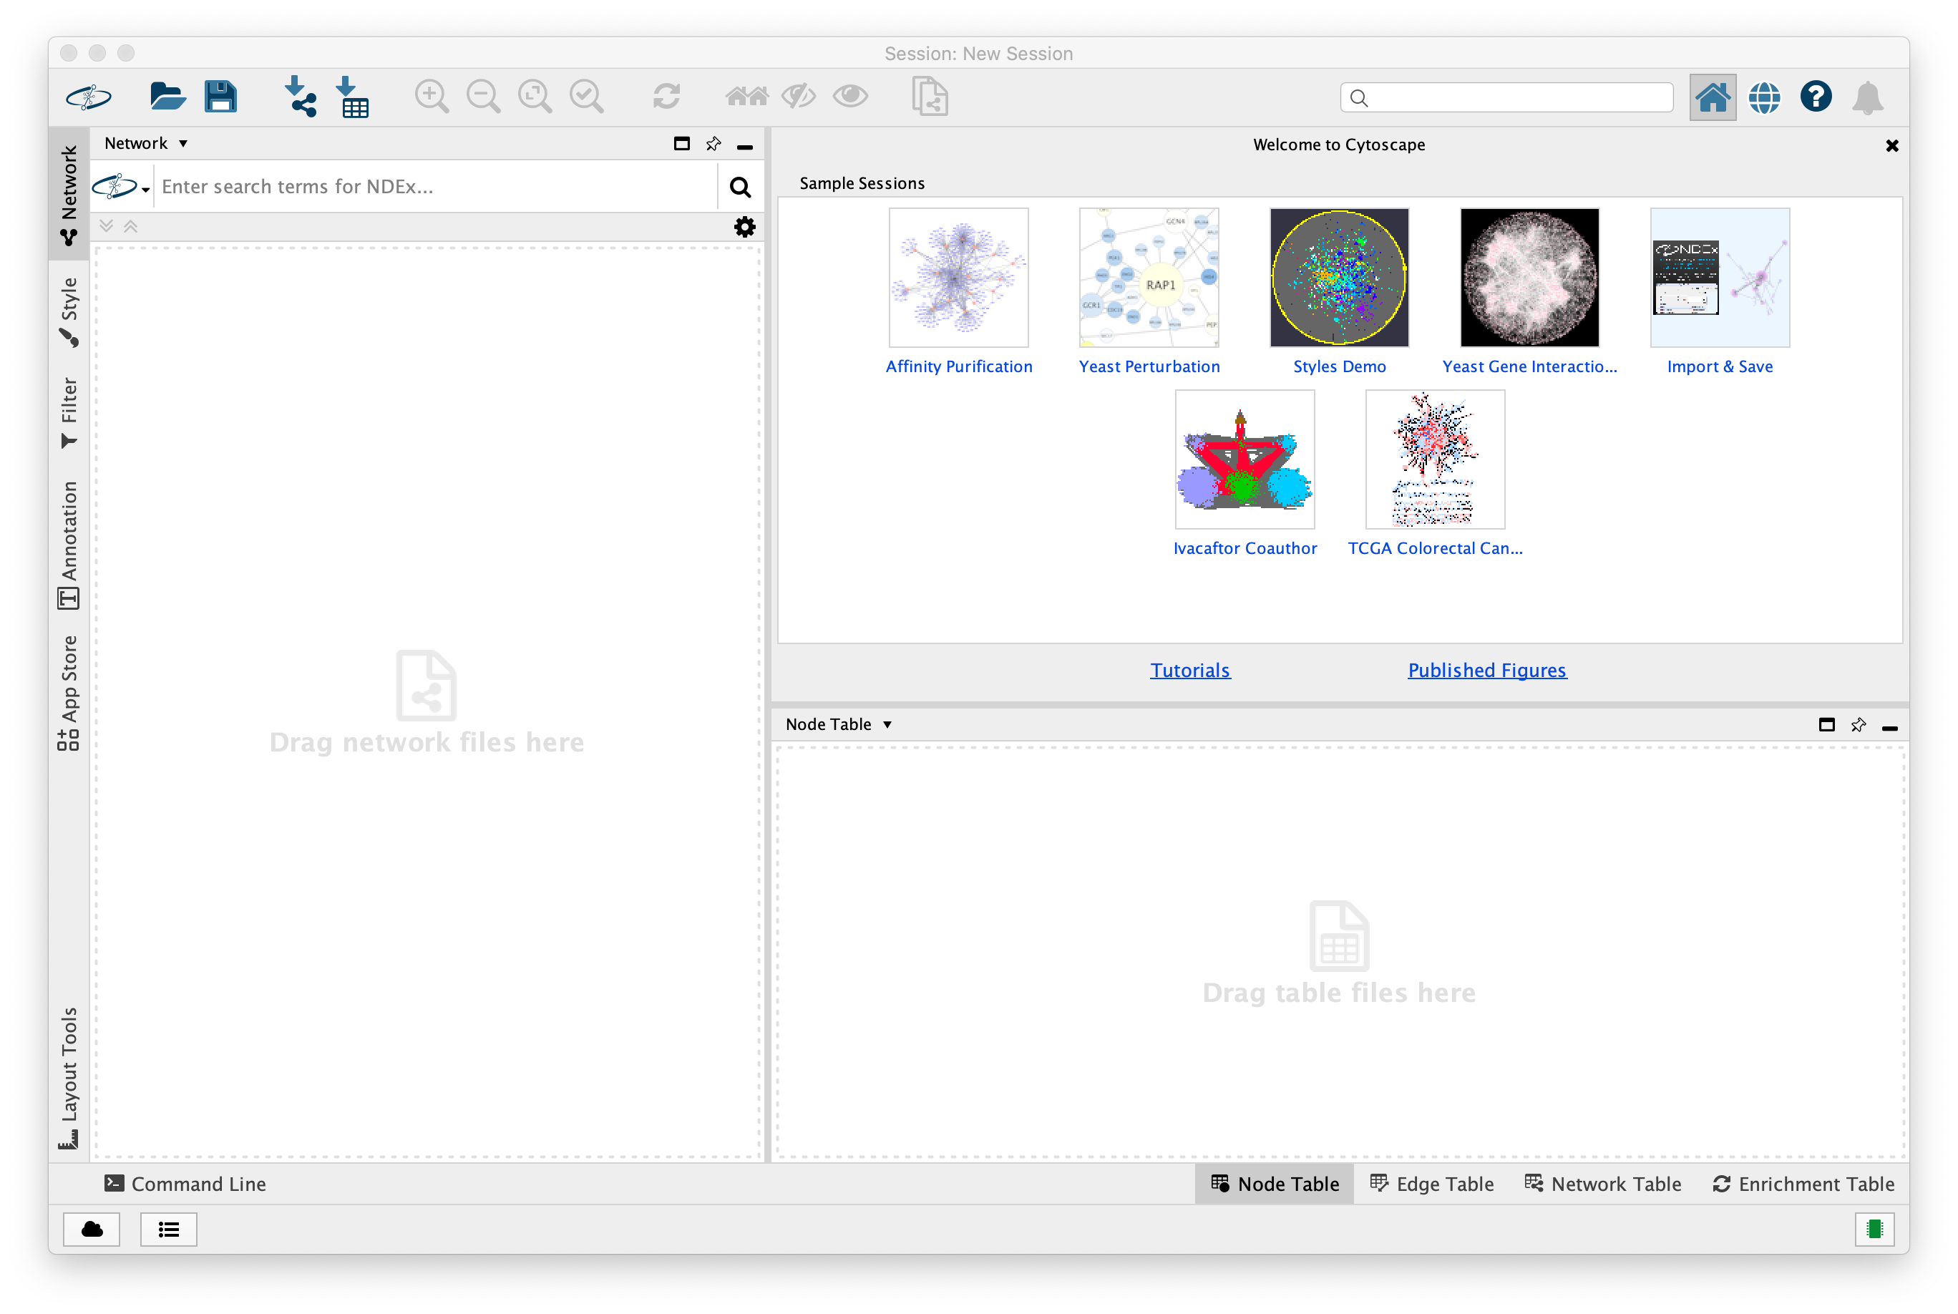
Cytoscape screen shots
Open Cytoscape

Slide 26
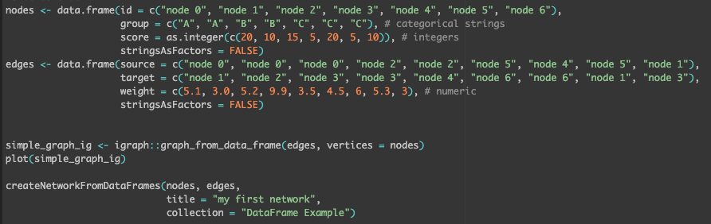
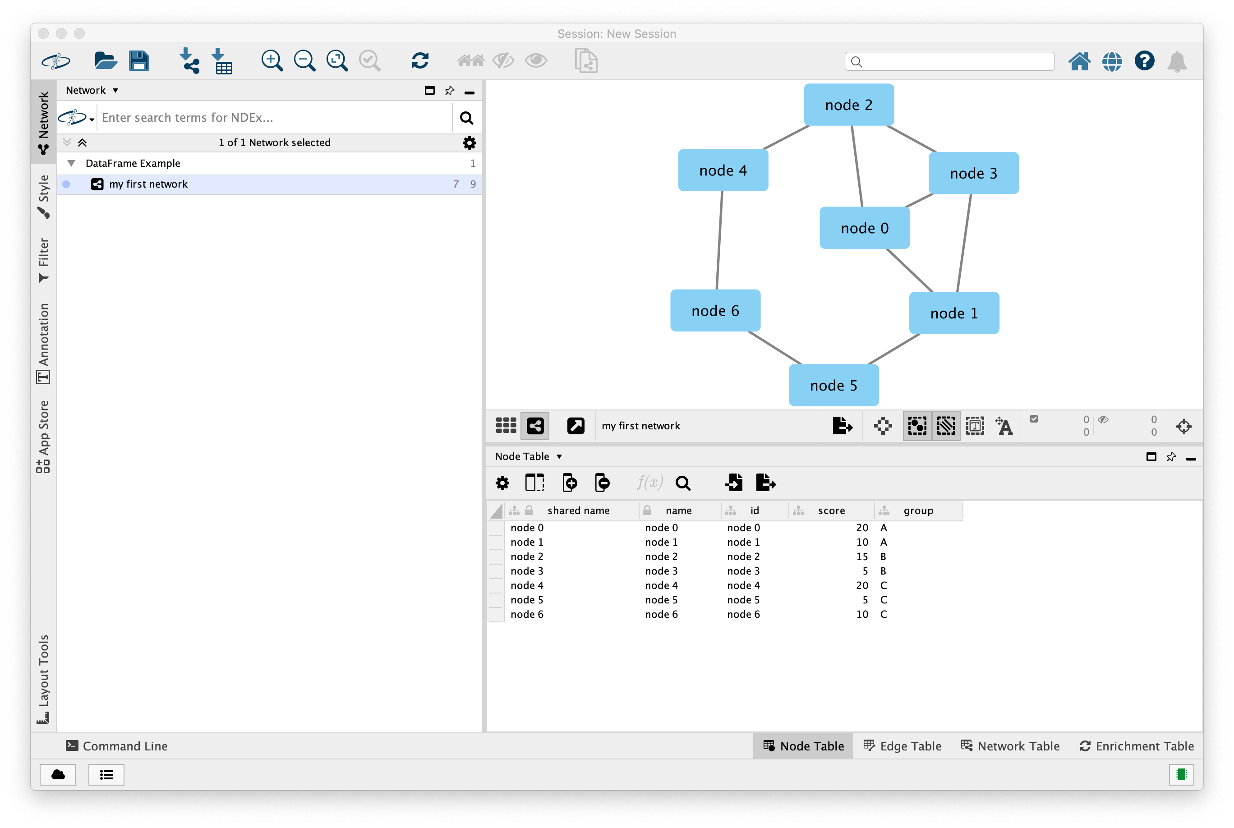

Slide 27
